Slide 1
COMPUTATION GRAPH
Deep Learning - Andrew NG
EDNA CRUZ FLORES
CUERNAVACA, MOR. AL 21 DE SEPTIEMBRE DE 2022

Slide 2
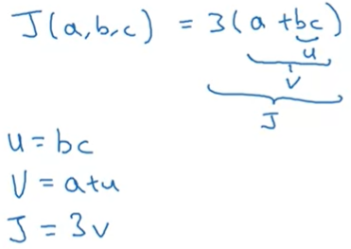
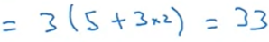
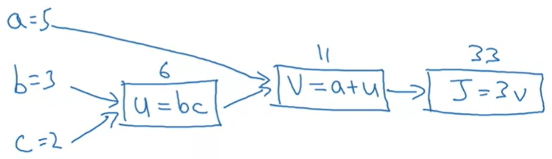
Computation graph
Computation graph of the J cost function in logistic regression or neural network.
Computation graph

Slide 3
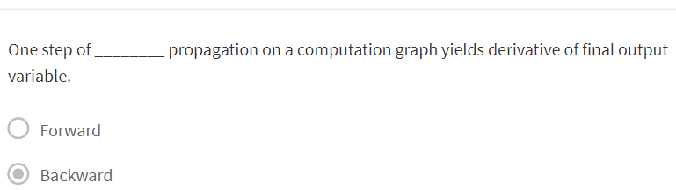
Question
X

Slide 4
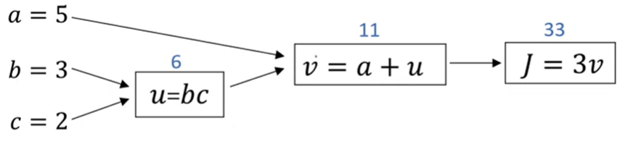
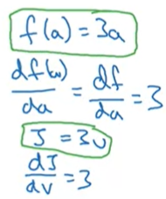
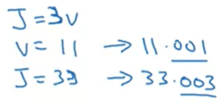


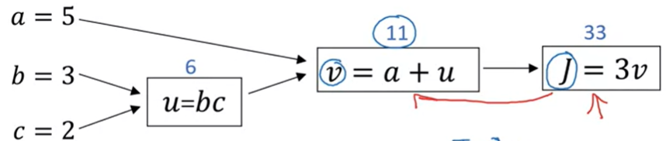
Derivatives with a computation graph
Computation graph of cost function J
Previous example
One step in backpropagation

Slide 5


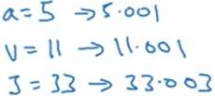




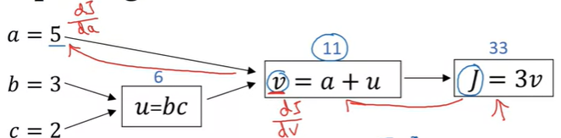
Derivatives with a computation graph
Chain rule
3 x 1
Second step in backpropagation

Slide 6
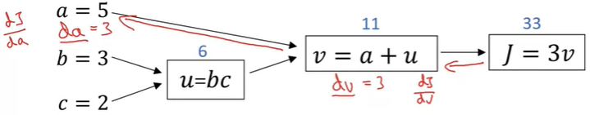




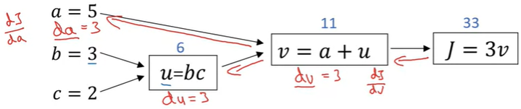
Computing derivatives
Third step in backpropagation

Slide 7




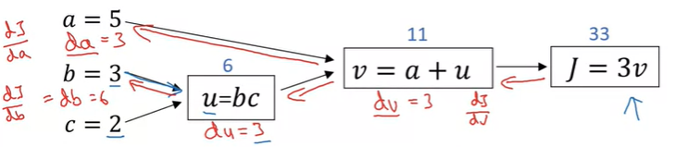
Computing derivatives
= 6
x
= 2
Fourth step in backpropagation

Slide 8

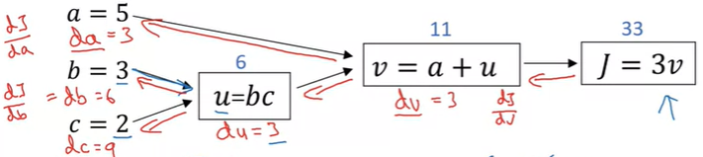
Computing derivatives
c = 2 2.001
u = (b) (c) 6.003
v = a + u 11.003
J = (3) (v) 33.009
9
3
3
Fifth step in backpropagation

